Slide 1
Automated PIN Cracking
R2B2 and C3B0
Justin Engler Paul Vines
Senior Security Engineer Security Engineering Intern

Slide 2
Agenda
Current PIN Cracking Methods
Cracking with Robots
R2B2
C3BO
Defeating the Robots

Slide 3
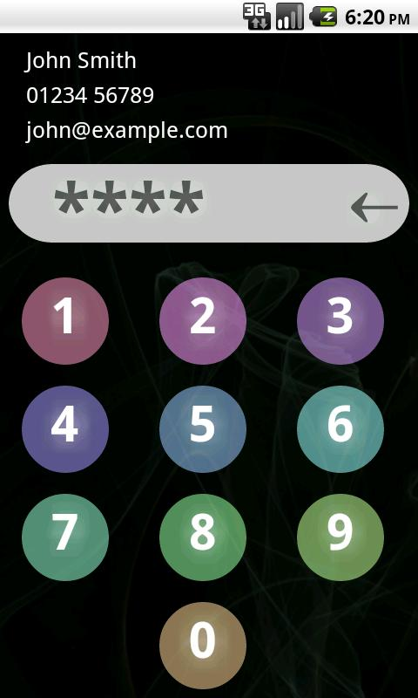
PINs
One of the most popular ways to lock mobile devices
Commonly still only 4-digit despite ability to be longer
User chosen, so typically low-entropy
play.google.com

Slide 4
PIN Cracking Now
Jailbreak and Crack
Keyboard Emulation
Brute Force the UI

Slide 5
PIN Cracking Now
Jailbreak and Crack
Keyboard Emulation
Brute Force the UI
Punish an Intern

Slide 6
Punish an Intern
Forcing your intern to try all 10,000 4-digit combinations will surely be more productive than anything else they could have been doing, except maybe getting coffee
Problem: Interns are universally bad at their jobs, so they might miss some of the combinations

Slide 7
PIN Cracking with Robots
Required Abilities:
“Push” buttons in sequence
Remember what buttons were pushed
Recognize success
Not always necessary

Slide 8
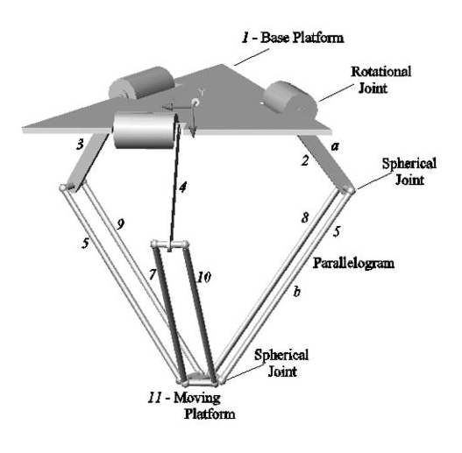
Delta Robot
*
Designed for fast precision industrial work
Simple combination of 3 single-motor arms gives precision 3D movement with somewhat small range of motion
Fairly simple motion control
* Lopez, Castillo, Garcia, and Bashir. Delta robot: inverse, direct, and intermediate Jacobians. Proc. IMechE Vol.220(2006)

Slide 9
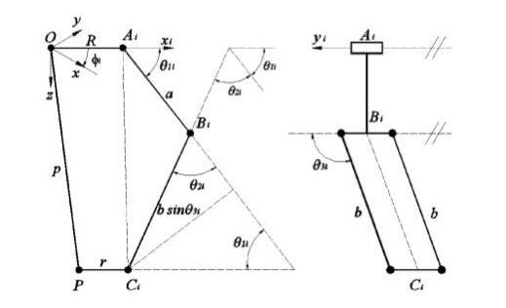
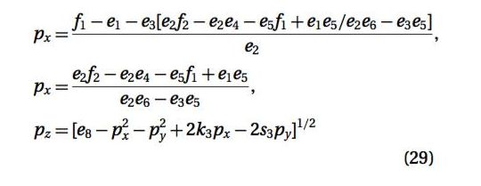
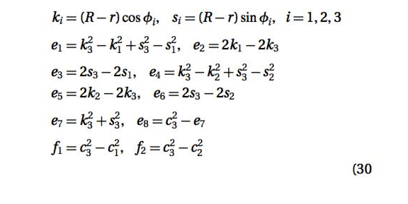
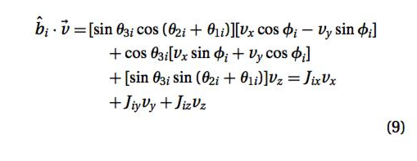
Still a lot of maths…

Slide 10
Still a lot of maths…

Slide 11
Robotic Reconfigurable Button Basher
Arduino microcontroller
3-d printed parts
Open source code and design for a delta robot by Dan Royer (marginallyclever.com)
Uses serial port communication to control the movement of the robot
Available as a kit, or DIY

Slide 12
Modifications
The original delta robot kit was modified to have its tool be a touch-screen stylus tip for pressing buttons
Important: Stylus tip needs to be grounded
A camera was added to allow easier user interface with the robot to set up the PIN cracking task
And recognize when the device is unlocked!
The motion control software was modified to speed up movement, up to 5 presses/second

Slide 13
Wrap Everything in Python
Controls the robot movement through the serial port
Performs image analysis of the camera feed
Provides a simple interface for the user to set the robot up for PIN cracking
Detects success of PIN cracking to stop robot and alert user

Slide 14
Capacitive Cartesian Coordinate Bruteforcing Overlay (C3BO)
Attach a grid of electrodes to the device’s virtual keyboard
Trigger electrodes via an Arduino to trick the device into thinking the screen was touched at that point
Faster, Better, Cheaper (~$50)

Slide 15
C3BO :(
Doesn’t work.

Slide 16
(a bit) Better than brute-forcing
Harvested 4-digit sequences from online password lists
(eharmony, myspace, etc.)
Presumably what Nick Berry did for his blog but wouldn’t share…
Combined with Daniel Amitay’s (danielamitay.com) phone app PIN list

Slide 18
Real Buttons Too!
R2B2 can of course also be used for brute-force PIN cracking of physical buttons as well
Electronic keypads or completely mechanical keys, provided it can detect when it has succeeded

Slide 19
Defeating the Robots
Forced delay timer after X attempts
On Android this is 30 seconds regardless of previous attempts
R2B2 would succeed in a worst case of ~20 hours
Likely success much sooner (80 mins =50%, 7 hrs =80%)
User Lockout after X attempts
On iOS, 1 minute lockout after 5 guesses
Lockout time quickly scales up for continued bad guesses (1 minute, 5 minutes, 15 minutes, 60 minutes)
Roughly 20% success rate on a 20 hour run

Slide 20
Robots > Apps
Lots of apps to replace lock screen or provide additional “protection” to elements of the phone (media storage etc.)
Tried 13:
4 had lockouts of >= 5 minutes/5 attempts
9 had no lockout at all

Slide 21
Defeating the Robots For Users
PIN character set and length | 1 PIN per second | 1 PIN per second, plus 30 seconds every 5 guesses
3 Digits | 16 Minutes | 117 Minutes
4 Digits | 167 Minutes | 19.4 Hours
5 Digits | 27 Hours | 8.1 Days
6 Digits | 11.8 Days | 81 Days
4 Lowercase + Digits | 19.4 Days | 136 Days
7 Lowercase + Digits | 2484 Years | 7.83e10 Centuries
4 Printable ASCII (94) | 2.48 Years | 7.81e7 Centuries
7 Printable ASCII (94) | 20563 Centuries | 6.48e13 Centuries

Slide 22
Acknowledgments
Thanks to iSEC Partners and the NCC Group for supporting this research
Thanks to Dan Royer for providing the motion control code and robot build plans
Thanks to Daniel Amitay for parts of our PIN data
Thanks to David Nichols for analyzing the PIN using apps

Slide 23
Contact Information
Justin Engler
@justinengler
Paul Vines
plvines@uw.edu

